Slide 1
Manual verification results of detection of similar projects

Slide 2
Description of this material
We need participants to decide whether competitor projects are similar to the project. This process may introduce personal bias. In order to alleviate this problem, we ask the four researchers to to evaluate the effectiveness of our detection of similar projects. The detailed process is shown in the next slide.

Slide 3
Process
Randomly select 1000 samples, including queried projects and projects that are considered as similar to queried projects by our automatic method.
Assign the 1000 samples to four Participants (i.e., the four researchers in our study).
For each sample, offer the four participants the URLs of the GitHub repositories and therefore can access the code, authors and contributors, readme file, related links and other information to assess similarity.

Slide 4
Similarity assess
We ask the following questions about the relevance of each retrieved repository to the query (This method is often used to evaluate the similarity of selecting similar items, e.g., [1-2]):
How relevant is the retrieved repository to the query repository?
(1) Highly Irrelevant, the participant finds that there is absolutely nothing in common between the retrieved and query repositories.
(2) Irrelevant, the participant finds that the two repositories have little in common.
(3) Neutral, the participant finds that the two repositories are marginally relevant.
(4) Relevant, the participant finds that the two repositories are similar on a number of aspects.
(5) Highly Relevant, the participant finds that the retrieved and query repositories are similar in most aspects, and even some parts may be identical.
[1] Yun, Z. , et al. "Detecting similar repositories on GitHub." IEEE International Conference on Software Analysis IEEE, 2017.
[2] Nafi, Kawser Wazed, et al. "A universal cross language software similarity detector for open source software categorization." Journal of Systems and Software 162 (2020): 110491.

Slide 5
Similar project detection Evaluation
We followed the evaluation provided by [1-2], that is, SuccessRate, Confidence and Precision.
(1) SuccessRate: if a retrieved project rating 4 or 5 by a participant, we consider this project to be successful detected by our automatic method. Then we use precision to evaluation the effectiveness of our method. We evaluated SuccessRate for four participants (i.e., labeler in this process) and the overall SuccessRate for all participants. The example is shown in the Table 1.

Slide 6
Similar project detection Evaluation
(2) Confidence: Median and mean confidence is defined as the median and mean relevance degrees participants give to all retrieved repositories recommended by a system. The example is shown in the Table 1.
(3) Precision is defined as the proportion of relevant and highly relevant repositories (i.e., whose final relevance degrees are equal to or greater than 4) among the recommendations that our method generates for a query.

Slide 7
Table 1. An example of the results of two queries
project | participant1 | participant2 |  | participant3 |  | participant4
query 1 | Precision for query 1: 0.250 (2/8)
retrieved 1 | 3 | 2 |  | 5 |  | 3
retrieved 1 | 3 | 1 |  | 5 |  | 3
query 2 | Precision for query 2: 0.667 (8/12)
retrieved 2 | 4 | 3 |  | 4 |  | 2
retrieved 2 | 4 | 5 |  | 4 |  | 2
retrieved 2 | 5 | 4 |  | 4 |  | 3
Confidence | Median:4 Mean:3.8 | Median:3 Mean:3 |  | Median:4 Mean:4.4 |  | Median:3 Mean:2.6
Confidence (ALL) | Median:3 Mean:3.45
SuccessRate | 0.600 (3/5) | 0.400 (2/5) | 1.000 (5/5) |  | 0.000 (0/5)
SuccessRate (ALL) | 0.500(10/20)

Slide 8
Consistency of assessment
Consider that the personal bias of different participants, we calculate the consistency of assessment by the Fleiss kappa coefficient.

Slide 9
Results
Our results contains 76 query projects and 924 retrieved projects.
The overall Kappa value of the four participants considering all queries is 0.72, which indicates substantial agreement between them.
The results of confidence and SuccessRate are shown in Table 2. The confidence box plot is shown in Figure 1 and the precision box plot is shown in Figure 2.

Slide 10
Table 2. Evaluation of the confidence and SuccessRate
project | participant1 | participant2 |  | participant3 |  | participant4
Confidence | Median:5 Mean:4.45 | Median:5 Mean:4.47 |  | Median:4 Mean:4.26 |  | Median:4 Mean:4.20
Confidence (ALL) | Median:4 Mean:4.345
SuccessRate | 0.967 | 0.962 | 0.811 |  | 0.786
SuccessRate (ALL) | 0.881

Slide 11
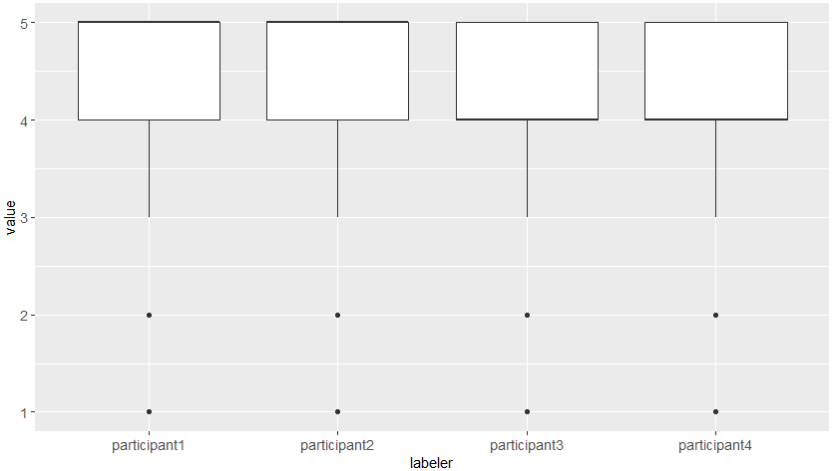
Figure 1. Confidence Box Plot

Slide 12
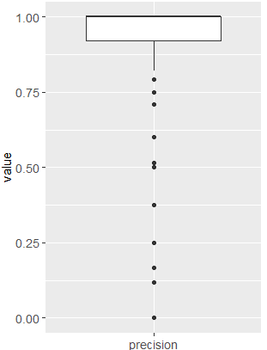
Figure 2. Precision Box Plot

Slide 13
Conclusion
From the results in Table 2 we can see that the mean confidence scores of our method is 4.345 and the median scores of our method is 4. At the same time the SuccessRate of our method is 0.881, which means that the retrieved projects selected by our method are very likely to be similar to the query projects.

Slide 14
Limitation
Although our method performs good in finding similar projects. We noticed two potential limitation from our method. First, we mainly use the similarity between descriptions of projects to find similar projects. However, not all projects decsribe their project content in the description. As a result, our method will miss this part of projects for a query project. Second, two projects that have similar descriptions do not means that they are similar to each other. For example, two project have description “wow addon” are projects that develop addons to a famous online game wow. The one can be a “quest addon” and the other can be a “chat addon”.
As a result, the similar projects selected by our method manly represents the projects that have very similar descripition to the query project.

